Slide 1
Natural Language Processing
Lecture 2: Basic Text Processing

Slide 2
Natural Language
Text
Speech
Image

Slide 3
Natural Language
Text
Speech
Image

Slide 4
Basic Text Processing
Word Tokenization
Word Normalization
Lemmatization
Morphology
Stemming
Sentence Segmentation
Regular Expressions

Slide 5
Words
What Counts As a Word?

Slide 6
Words
He stepped out into the hall, was delighted to encounter a water brother.
How many words are in the above mentioned sentence?
13 words (15 with punctuation marks)
How many words are in the following utterance from the Switchboard corpus?
I do uh main- mainly business data processing
Two disfluencies: a fragment (main-) and a filled pause (uh)

Slide 7
Bags vs Bag

Slide 8
Bag vs Bags
How about inflected forms like bags versus bag?
They have the same lemma bag but different wordforms
A lemma is a set of lexical forms having the same stem, the same major part-of-speech, and the same word sense
The wordform is the fully inflected or derived form of the word

Slide 9
How many words?
The UK says the Russian satellite launched a projectile with the characteristics of a weapon
Number of distinct words?
13
Total Number of Words?
15
Types: number of distinct words
Tokens: Total number of words
چین نے امریکہ کے اقدام کے بعد چینگڈو میں امریکی قونصل خانے کو بند کرنے کا حکم دیا ہے
Types: 18
Tokens: 19

Slide 10
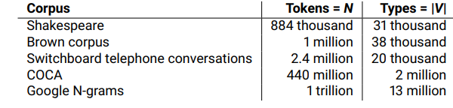
How many words are there in English Language
Corpus: A collection of written texts

Slide 11
First nlp task

Slide 12
Simple Word Tokenization
Given a text file, output the word types and their frequencies
Open File
Read File
Split Words
Check Word
if already exist, increment value
Else add word and set value 1

Slide 13
Simple Word Tokenization in Python
import os def word_frequencies(text): myDict = {} for word in text.split(): if word in myDict: myDict[word] += 1 else: myDict[word] = 1 return myDict f= open("test.txt","r") str = f.read() wf = word_frequencies(str) print(wf)

Slide 14
Word Tokenization Main Challenges
Break off punctuation as a separate token but preserve it when it occurs word internally (Ph.D., Dr., ...)
Keep special characters and numbers in prices ($45.55) and dates (15/02/2019)
Expand clitic contractions that are marked by apostrophes (we’re → we are)
Tokenize multiword expressions like New York or rock ’n’ roll as a single token

Slide 15
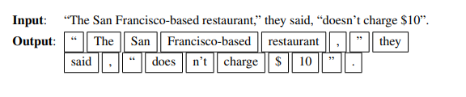
Penn Treebank Tokenization
Penn Treebank tokenization standard separates out clitics (doesn’t becomes does plus n’t), keeps hyphenated words together, and separates out all punctuation:

Slide 16
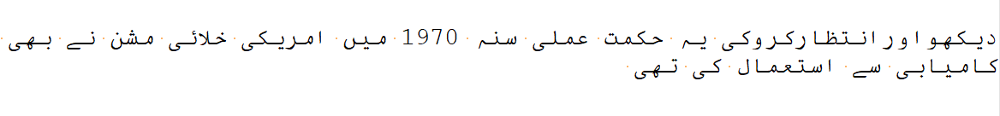
Word Tokenization: Language Issues
دیکھو اور انتظار کرو کی یہ حکمت عملی سنہ 1970 میں امریکی خلائی مشن نے بھی کامیابی سے استعمال کی تھی
اسلام آباد

Slide 17
Tokenization: language issues
Chinese and Japanese no spaces between words:
莎拉波娃现在居住在美国东南部的佛罗里达。
莎拉波娃 现在 居住 在 美国 东南部 的 佛罗里达
Sharapova now lives in US southeastern Florida
Further complicated in Japanese, with multiple alphabets intermingled
Dates/amounts in multiple formats

Slide 18
Word Tokenization in Chinese
Also called Word Segmentation
Chinese words are composed of characters
Characters are generally 1 syllable and 1 morpheme.
Average word is 2.4 characters long.
Standard baseline segmentation algorithm:
Maximum Matching (also called Greedy)

Slide 19
Maximum Matching Word Segmentation Algorithm
Given a wordlist of Chinese, and a string.
Start a pointer at the beginning of the string
Find the longest word in dictionary that matches the string starting at pointer
Move the pointer over the word in string
Go to 2

Slide 20
Max-match segmentation illustration
Thecatinthehat
Thetabledownthere
Doesn’t generally work in English!
But works astonishingly well in Chinese
莎拉波娃现在居住在美国东南部的佛罗里达。
莎拉波娃 现在 居住 在 美国 东南部 的 佛罗里达
Modern probabilistic segmentation algorithms even better
the cat in the hat
the table down there
theta bled own there

Slide 21
Word normalization
What Counts As a Token

Slide 22
Normalization
Need to “normalize” terms
Information Retrieval: indexed text & query terms must have same form.
We want to match U.S.A. and USA
We implicitly define equivalence classes of terms
e.g., deleting periods in a term
Alternative: asymmetric expansion:
Enter: window Search: window, windows
Enter: windows Search: Windows, windows, window
Enter: Windows Search: Windows
Potentially more powerful, but less efficient

Slide 23
Case folding
Applications like IR: reduce all letters to lower case
Since users tend to use lower case
Possible exception: upper case in mid-sentence?
e.g., General Motors
Fed vs. fed
SAIL vs. sail
For sentiment analysis, Machine Translation, Information extraction
Case is helpful (US versus us is important)

Slide 24
Lemmatization
Reduce inflections or variant forms to base form
am, are, is → be
car, cars, car's, cars' → car
the boy's cars are different colors → the boy car be different color
Lemmatization: have to find correct dictionary headword form
Machine translation

Slide 25
Morphology
Words are not atoms
They have internal structure
They are composed (to a first approximation) of morphemes
Morpheme: a meaningful morphological unit of a language that cannot be further divided
mis-understand-ing-s
Incoming: in-come-ing
Notes:
Each of these morphemes can occur at different places

Slide 26
Morphemes
Stems: The core meaning-bearing units
Affixes: Bits and pieces that adhere to stems
Often with grammatical functions
Prefixes
pre-nuptual, ir-regular با اختیار
Suffixes
determin-ize, iterat-or دولت مند
Infixes
Cup-s-ful
عاقبت نا شناس
اکابر
Rare in English
Circumfixes
En-light-en
نا خوش گوار
Notes:
Circumfixes attached to both the beginning and end of the word

Slide 27
Nonconcatenative Morphology
Word-formation in which the root is modified in a way other than by stringing morphemes together
Umlaut
foot : feet :: tooth : teeth
Ablaut
sing, sang, sung
Notes:
Umlaut : A different vowel
Ablaut: a systematic variation of vowels in the same root or affix

Slide 28
Functional Differences in Morphology
Inflectional morphology
Adds information to a word consistent with its context within a sentence
Examples
Number (singular versus plural)
automaton → automata
الفاظ → لفظ
پودا → پودے
Walk → walks
Case (nominative versus accusative versus…)
he, him, his,
Derivational morphology
Creates new words with new meanings (and often with new parts of speech)
Examples
parse → parser
repulse → repulsive
خوش بخت

Slide 29
The Problem and Promise of Morphology
Inflectional morphology (especially) makes instances of the same word appear to be different words
Problematic in information extraction, information retrieval
Morphology encodes information that can be useful (or even essential) in NLP tasks
Machine translation
Natural language understanding
Semantic role labeling

Slide 30
Morphology in NLP
The processing of morphology is largely a solved problem in NLP
A rule-based solution to morphology: finite state methods
Other solutions
Supervised, sequence-to-sequence models
Unsupervised models

Slide 31
Basic Text Processing
Word Tokenization
Word Normalization
Lemmatization
Morphology
Stemming
Sentence Segmentation
Regular Expressions

Slide 32
To-do
Create a corpus of at least 10 files (you can copy text from different webpages)
Read your corpus
Calculate Types
Calculate Tokens
Calculate Frequency of Each Type

